Slide 1
DJ Hardware Status

Slide 2
Overview – DJ Development Stages
Specification – Finalized May 31st.
  Includes first order user features
  Includes ship volumes and distribution channels
DVT – Design Verification Test – In Progress
  DVT complete when one hand built unit meets features
Regulatory, Reliability – Start in October
  Regulatory – UL, FCC, FDA, UPC
  Reliability – ESD, Environmental Stress, Vibration
    Minimize returns from defects post-sale
DFM/DFT - Design for Mfg./Test – Start in October
  Simplify Supply Chain – cost and risk/predictability
  Simplify Assembly and Test – cost and risk/predictability
  Simplify Return and Repair – cost and customer satisfaction
Pilot Run, Release to Mass production – Start Feb’03
  Teach contract manufacturer how to run assembly and test
  Release when CM can operate w/o Fullplay daily presence
Notes:
Even simpler Summary is: DVT, Regulatory+DFM, Mass Production
NEW since last presentation: EVT done, DVT RC1 is Rev-03-E == Rev-04-A electrical
Functional DVT only fine tuning left. May ship with cold-power-on pop.

Slide 3
DJ-35
Time: 13 weeks (Mar15 to Jun21)
  ~1 week late
Cost: ~$90K
  Includes hard costs, Fiori labor, no Fullplay soft costs
Quantity: 50 units
  35 in cases, 15 open boards
Goals: Support Dev, Test, Beta, Sales
  Accelerate SW dev – Success: 15 units used in SW dev and test
  Accelerate HW dev – Success: 4+ units used to prototype new features and test current design – Electrical “Rev 0.8”
  External User Beta – Success: 10 DJs in user’s homes for 1 month
  Retail Support – Success: demo to major retail purchasers
Non-Goal: Mechanical
  Mechanical at “Rev 0.5” – no useful testing on this revision

Slide 4
Proto-2 (In Progress)
Time: 3 Months (Jul15 to Oct15)
  Tried to do in 2 months, most line items slipped by several days
  Rev-03a Electrical arrived Friday Aug. 23rd
  Proto-2 Mechanical (ProE) released Aug. 14th
Cost: ~$70,000 direct + $100K Fiori labor
  Includes hard costs, Fiori labor, no Fullplay soft costs
Quantity: 50 units
  37 in cases, 13 open boards
Goal: New Features – EE/ME “Rev 0.9”
  Audio output (and input) “louder” - 2.0 Vrms
  S/PDIF Digital Optical Audio Output
  RS-232 serial port for custom installer control
  fixed bugs from rev v0.8
Goal: Use for DFM/DFT, Regulatory, Reliability
  Designed to specs from manufacturing and prelim UL review
Notes:
How much more Proto-2 money? Nov 1st. Is box build done date.
$ Fiori + $ Route, Fab, ASY, HLA Box Build

Slide 5
Key Decisions
Regulatory and Reliability
  How reliable? (return rate assumptions vary)
Mass Production
  Risk/Predictability
  Financing
Critical Assumptions
  Build 1,000 units for launch
  Plan for 5,000 units for CY’03
    500/month or 1,500/quarter?
  Support marketing options by “Readiness” to ship 5,000/month demand
    Ready to ramp/demonstrate ability to increase production to 5,000/month cost effectively and predictably
Notes:
[] Reliable: shipping can be solved by good packaging design, AND by carrier choice, AND by managing quality of sheet metal and plastic creation, (and box assembly, screw torque).
[] Increase testing confidence and reduce time by increasing on-site support.
[] Faceplate still a concern since it effects button feel. Fiori did NOT! Put “final” into Proto-2. Need to at least be notified, why wasn’t this on their risk list?
[] Check environmental stress and shake for effect on cosmetics, not just functional. Will it wipe off silk-screens?
[] Mass Production: build 1000 on shore has many advantages, including establishing our IP ownership

Slide 6
Key Decisions – Regulatory and Reliability
UL – Life/Safety issue – Liability
  Must do - UL vs. ETL?
FCC – legally required
FDA – need more data re: laser cert
ESD – may result in design changes
Environmental Stress – “How reliable do we need to be?”
  Heat, Humidity, Altitude, Vibration in carton, w/o carton
  Perform in house for first launch
UPC registration (underway)
Notes:
Option: perform more rigorous reliability testing after first 1,000 – 2,000 units sell

Slide 7
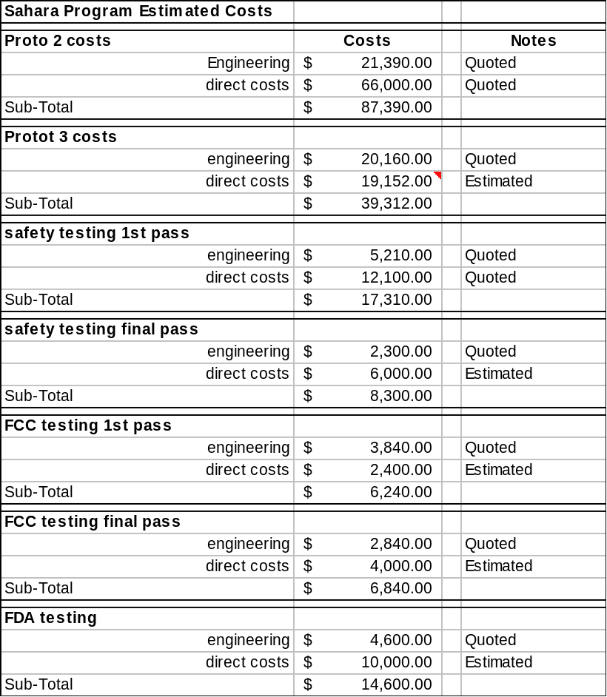
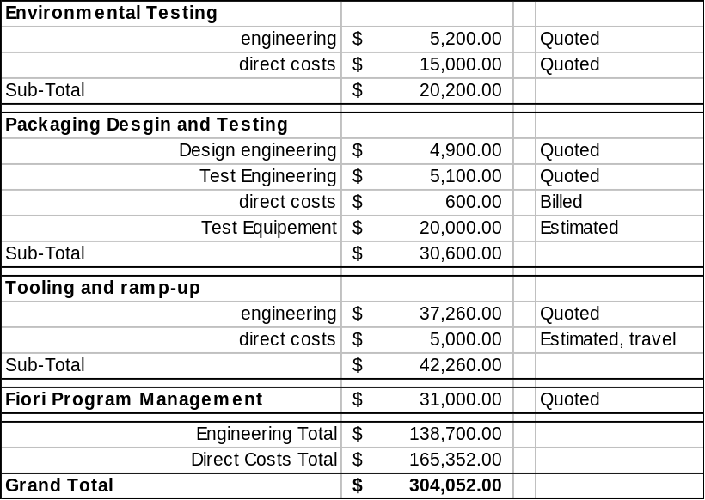
Budget To Finish DVT
Fiori accounts for 100% of Engineering
Summary does not include Mfg. related costs
Notes:
Costs assume pay for out of house tests and Firori management time
Schedule assumes 3rd party test in parallel with in house development
Stress that this does not include $50K tooling NRE, or Mfg. NREs
Bring thermal map in house, and seagate wrp to HDD
Spec altitude, humidity, from HDD, CDD, LCD specs
Bring out of package shock/vib tests in house
Do in package shock vib at packaging vendor only
UL will also get some out of package shock vib data

Slide 8
Key Decisions – Mass Production
“This is not Albertson’s” – Arch Holder
  Supply Chain Management
  Component Purchase Agreements i.e. warranty
Next $275K order for second 1K run in December (before pilot run)
  Unless we closely manage Supply Chain; not the UB model
Mfg./Test fixtures must be developed
  ICT test fixture – (program and jig)
  Functional test fixture
  HDD mass duplicator
  Other box assembly fixtures
Fixtures for Return/Repair centers
  in house for first 1,000 – we need to learn what goes wrong before training external vendors

Slide 9
United Box – Reducing Risk
Create scriptable/modular test interface
  Include test in app? Eliminate separate factory test?
Hand wire bare display boards for Functional test fixture
Take over tooling +$50K hard cost NRE
  Fiori bid and manages delivery from Korea/Taiwan +$ Fiori labor
  Take over supply chain portion for plastics+metal -$ from UBox
  Manage tool lifetime proactively
  Reduce UB per unit to reflect
Consider new “pay as you go” financing model for next build
  Also know when components used so we can return un soldered components
Extended plans
  Get new quotes from Flex and DDI – 2 weeks away
  United Box ‘kits’ Qty. 8 PCAs and box builds from UB supply chain to Bellevue
    We create Known Good boards before going to China
Notes:
[] Add features to ease data collection? Make this available to test centers only. Log P.O.S.T. to HDD?
[] CM does not know how robust design is. Plan on 90% to 95%. But how long to repair 5% is key part of reducing value add cost.
[] Build “failure tree”. Provide Failure
[] How do we “test” touch and feel on assembly line. And cosmetic LCD lens and LED brightness.
[] Fiori tool development can improve the schedule also. Fiori will manage CAD release and ECO updates.
[] Emphasize that we can get $50k or more back from Ubox.
[] Do NOT have Fiori manage the delivery. But, then we still need
[] *** Switch travel has +/- 0.10 mm on a 0.25mm travel !!!
[] Fully seating an IDE cable is an act of congress.
[] Also – Do CPA Fullplay with supplier – and then Fullplay approve assign CMs to execute against this CPA.
This Improves ability to move to other CMS, and supplier wins because they get higher confidence that they will maintain design win when we move CMs.

Slide 10
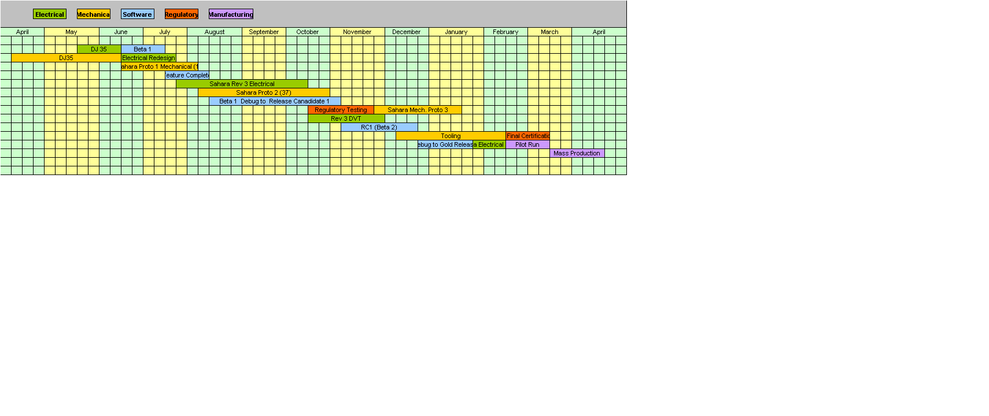
Sahara Project Summary
Sahara Project Summary
Notes:
Shipping from China, and U.S. distribution delays NOT included

Slide 11
Remaining Work on DJ
September ’02
  EE – 8 Rev-03a PCBAs in the lab now
    Use for cursory feature test
    Use for early SW dev on S/PDIF and serial
  EE – Build 42 Rev-03b PCBAs
  Negotiate CPAs
October ‘02
  EE – DVT October and November
    EE- Major known bugs remaining
      7312 Audio input format
      Ethernet and SDRAM timings
      Audio “pops” between tracks and on input gain change
  DFM - Design For Manufacturing
  DFT – Design for Test

Slide 12
Remaining Work on DJ (cont.)
October and November ’02
  FCC
  UL
  ESD
  Environmental Stress
    Temperature, humidity, altitude
  Shock/Vibration
  Mechanical – Proto-2 fit test and build
  Mechanical – Build 37 Proto-2 and Rev03b Boxes using sample assembly procedure
December ’02 and January ‘03
  DFM – Develop Factory Test fixtures
    SW code, and mechanical jigs
    ICT for PCBs
    Order test equipment

Slide 13
Remaining Work on DJ (cont.)
February ’03
  Pilot Run
March ’03
  Mass Production
April ’03
  Ship DJ’s from Hong Kong
    No shipping delay if Flextronics or DDI
May ‘03
  DJ’s on store shelves.

Slide 14
Risk and Predictability
Chance of first Pilot Run DJ not working is 100%
  True for Flextronics or United Box
  Is United Box first 1,000 2-3 days or 4-5 weeks?
Supply Chain more complex than LVS
  Time to Market (TTM) matters every month
Notes:
Arch - TTM matters every DAY!!! TTM every month means willing to live with 1 –2 month slip. Every day means 1-2 day slip. Make this up in shipping.

